Slide 1
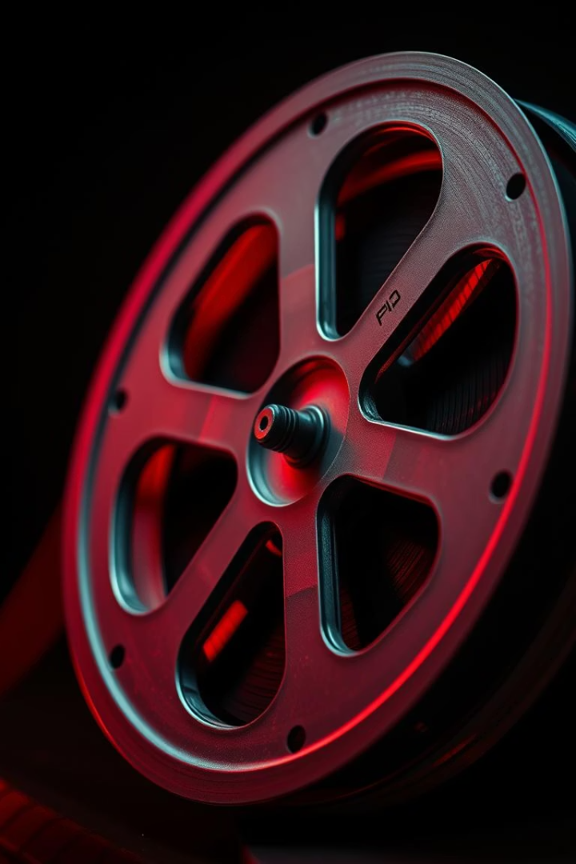
Image Colorization using GANs
Grayscale to Color Image Translation using PatchGAN and U-Net.
Sahil Raj, 220150018.

Slide 2
Introduction
1
Automatic Colorization
2
Generative Learning
3
Overcoming Limitations
GANs learn from data how to add color to grayscale images.
Automated colorization of images has long been a field of interest.
Our work aims to improve speed and stability.
Colorizing grayscale images has uses such as photo restoration. GANs introduce color from data. Earlier methods depended on hand-designed rules and user intervention.

Slide 3
Datasets
CelebA
Subset
Color Space
CelebA dataset was used. It contains about 200,000 color images of faces.
A subset of 10,000 images was selected. 80% was for training, 20% for validation.
Images converted from RGB to Lab color space for grayscale input.

Slide 4
Why Use Lab Color Space?
1
Luminance Separation
2
Perceptual Uniformity
L represents brightness. A and B represent green-red and blue-yellow.
Equal changes in values mean equal changes in perceived color.
helps the model focus only on predicting colors (a, b) while keeping brightness fixed.
helps in minimizing color distortions during training.
3
Stable Training
4
Grayscale Input
Color and intensity are mixed in RGB, which makes training harder.
L channel is direct input. It does not require conversion of color to grayscale.

Slide 5
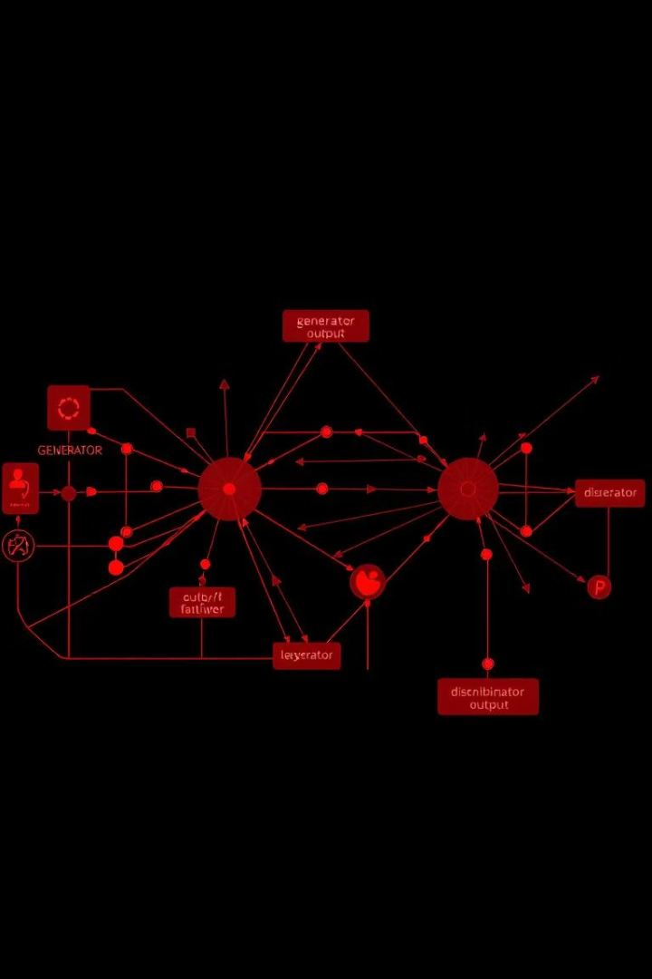



GANs
Generator
Creates colorized images from grayscale input.
Discriminator
Distinguishes real vs. fake colorizations.
Adversarial Training
Iteratively improves realism through competition.
GANs consist of Generator and Discriminator networks.

Slide 6
Conditional GAN
Conditional GAN
Mapping
From Grayscale to Color
Grayscale input (L channel) is the condition.
Generator learns L to AB channels.
No random noise as input.
Conditional GANs map grayscale to colors. Generator focuses on color creation. Training becomes stable and efficient.

Slide 7
Model Architecture
Generator (U-Net):
Discriminator (PatchGAN):
Inputs: Grayscale image (L channel)
Takes combined image (L + ab)
Outputs: Color channels (a and b)
Outputs: Real/Fake decision for each patch
Structure: Encoder-Decoder with skip connections
Focuses on local textures rather than the entire image

Slide 8
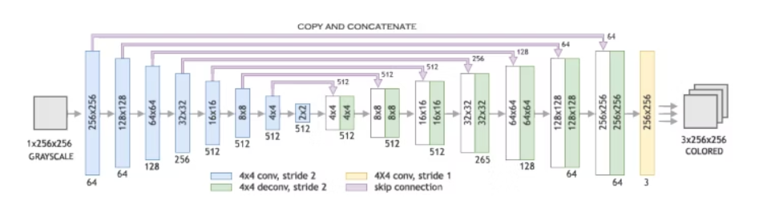
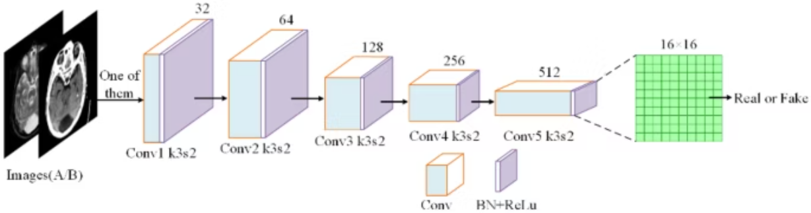

Slide 9





Training Details
Batch Size
Set to 16.
Optimizer
Adam.
Learning Rate
Gen =2e-4, Dis=2e-4
Epochs
Training lasted for 20 epochs.
Weight Initialization
Normal

Slide 10
Results and Evaluation
Performance metrics across training epochs are crucial. These reveal model learning trends. We evaluate loss functions of both discriminator and generator.
Loss Metric
Epoch 5
Epoch 10
Epoch 15
Epoch 20
loss_D_fake
0.55271
0.58009
0.60650
0.62224
loss_D_real
0.60198
0.63222
0.64532
0.64407
loss_D
0.57735
0.60615
0.62591
0.63316
loss_G_GAN
1.14168
1.04498
0.96457
0.91493
loss_G_L1
7.30180
6.77980
5.78608
4.89597
loss_G
8.44348
7.82478
6.75065
5.81090

Slide 11
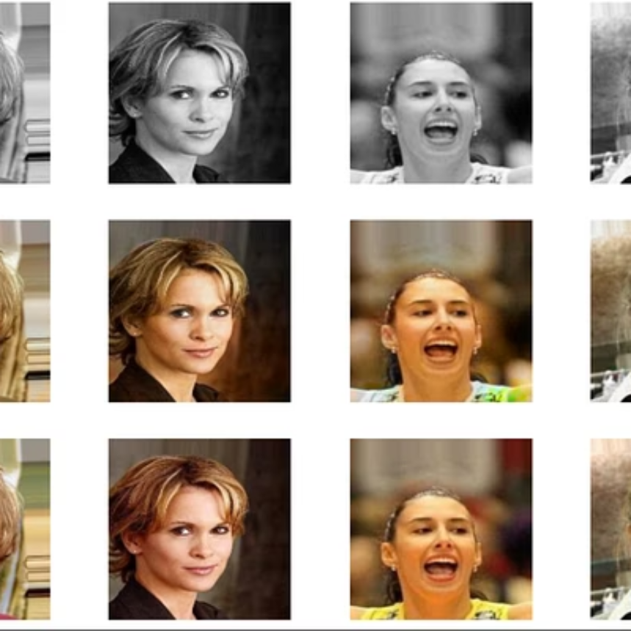
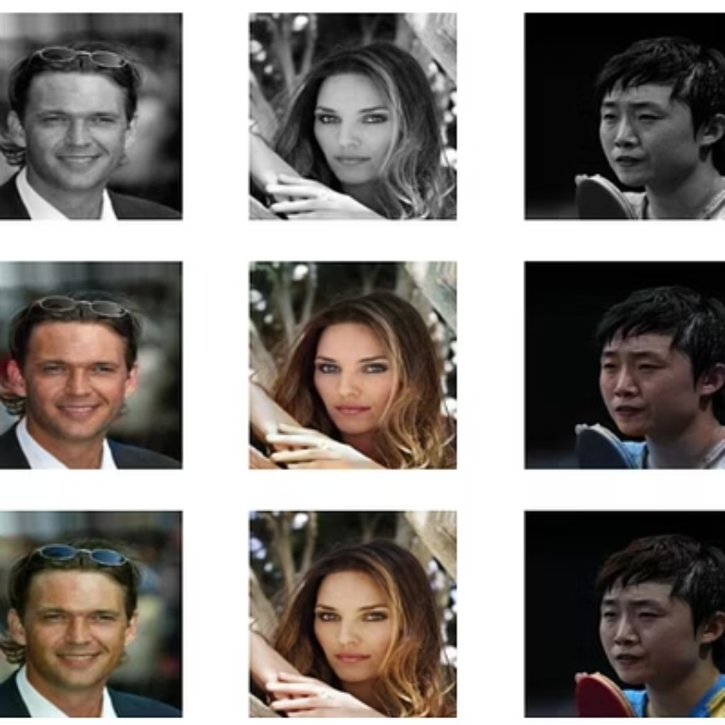

Slide 12
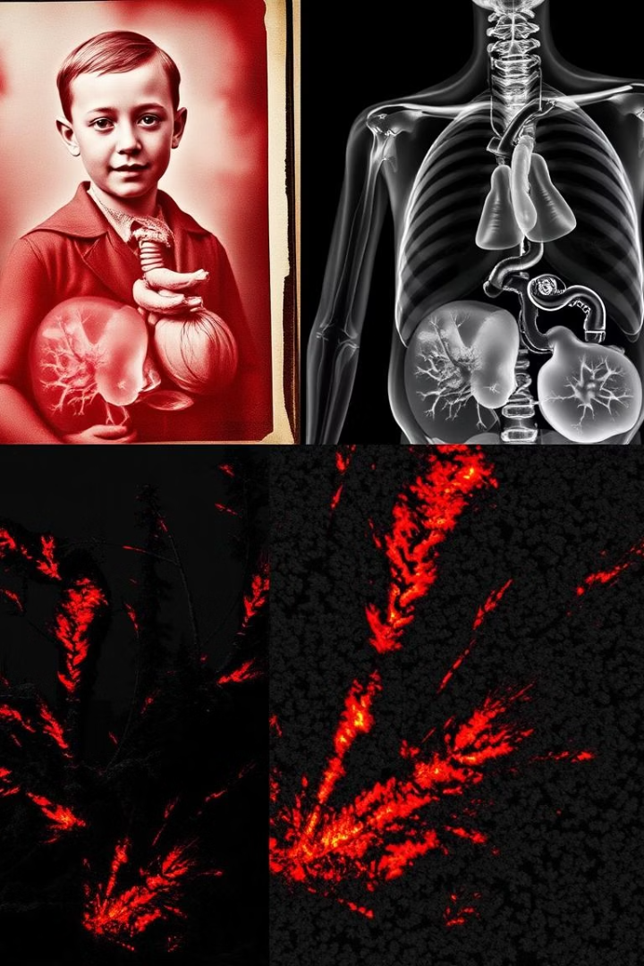
Applications of Image Colorization
Restoring Photos
Reviving old photos and films with realistic color.
Medical Imaging
Converting grayscale medical images to color for better analysis.
Satellite Imagery
Enhancing satellite imagery for improved interpretation.
Colorizing Videos
Adding color to black and white videos.

Slide 13
Thank you

